Slide 1
Was sherlock holmes a woman?
“My life,” said Holmes, “is spent in one long attempt to escape the commonplaces of existence.”
--The Red-Headed League

Slide 2
The idea…
Sherlock Holmes was a woman, probably named Charlotte…
… who spent her life disguised as a male detective to escape the strictures of Victorian society.
She had many lovers. Including John Watson.
She gave birth to at least two children.
Only her brother Mycroft and Watson knew her secret.
Notes:
Sherlock Holmes has been labeled as gas. Watson has been called a woman.
So why not declare that Holmes was a woman in disguise

Slide 3
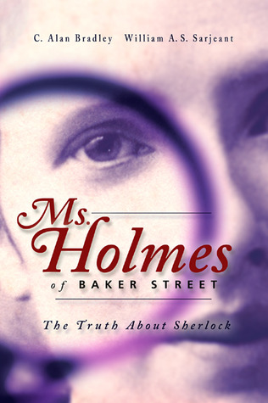
MS. HOLMES OF BAKER STREET
BY ALAN BRADLEY AND WILLIAM SARJEANT
CANADIAN SCHOLARS AND SHERLOCKIANS
Notes:
Background, recluse, how this was possible.

Slide 4
Holmes’ limits
Knew nothing about:
Books
Politics
Astronomy
But did know about:
Botany
music
Holmes had the limited education of a Victorian woman.

Slide 5
DOESN’T LIKE WOMEN..
Doesn’t approve of Watson’s marriage to Mary
Indifferent to beautiful women (while Watson is not)
But…admires Irene Adler
Holmes was a woman, so (s)he was not interested in them.
(S)he had something in common with Irene.

Slide 6
Strange behaviors…
Holmes disappears to Europe (Reigate Puzzle)
Is often moody and indisposed
The Great Hiatus
Holmes rejects a knighthood
Holmes left, or disappeared, to cover up illegitimate pregnancies.
Holmes suffered from PMS.
How can a woman be a knight?

Slide 7
Relationship changes
Holmes and Watson become more affectionate
Watson makes veiled references to Holmes’ real identity
Ambiguous sharing of rooms, appearing in states of undress
Holmes and Watson were lovers.

Slide 8
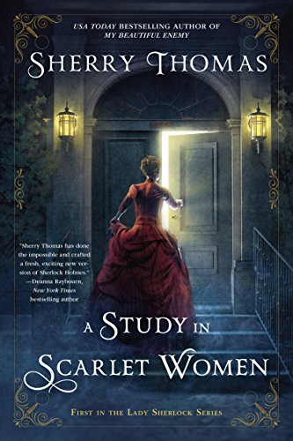
If you’re curious…
The backstory of Sherlock Holmes (really, Charlotte)
Next book, A Conspiracy in Belgravia, comes out Sept. 5, 2017

